Slide 1
Lab 4 Objectives and Requirements
Be able to do integer math (modulus and division as tools)
Understand Long data type
Be able to construct a loop statement
Be able to break down and modularize code
Understand casting
No arrays
Due Wed 2/15
1

Slide 2
Integer Math
Basic integer math rules:
integers and longs cannot store decimal points
  Example
  123456/10 = 12345.6
    but if the answer is stored as an integer, the result would be 12345
Modulus is used to calculate the remainder
  9 % 2 = 1
  123 % 10 = 3

Slide 3
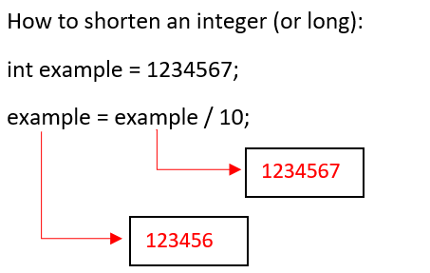
Integer Math Examples
An Introduction to Programming with C++, Seventh Edition

Slide 4
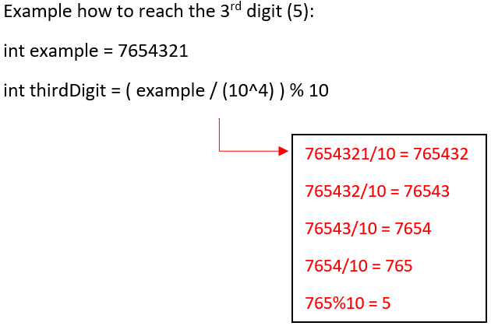
Integer Math: How to Reach a Digit in the Middle of an Integer

Slide 5
Lab 4 Credit Card Validation
Create an IPO and write a program that prompts the user to enter a credit card number as a long integer (e.g., long var). Display whether the number is valid or invalid. Design your program using appropriate method – i.e., design your own methods that does the series of computation and validates the card.
Credit card validation Problem. A credit card number must have between 13 and 16 digits. It must start with:
  4 for visa cards
  5 for mater cards
  37 for American express cards
  6 for discover cards

Slide 6
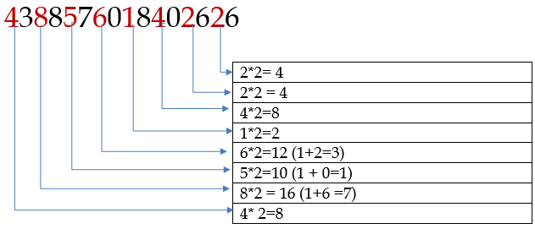
Lab 4 Credit Card Validation cont.
Consider a credit card number 4388576018402626
Step1: double every second digit from right to left. If doubling of a digit results in a two-digit number, add up the two digits to get a single-digit number.

Slide 7
Lab 4 Credit Card Validation cont.
Step2: now add all the single digit numbers from step1
  4 + 4 + 8 + 2 + 3 + 1 + 7 + 8
Step3: add all digits in the odd places from right to left in the card number
  6 + 6 + 0 + 8 + 0 + 7 + 8 + 3 = 38
Step4: sum the results from step 2 and step 3
  37 + 38 = 75
Step 5: if the results from step 4 is divisible by 10, the card number is valid; otherwise, it is invalid. In this case, the card number is not valid – because 75 not divisible by 10. (Hint: modulus operator)

Slide 8
Example Credit Card Numbers
Use these numbers to help test your code. Hint, these examples do not test all possibilities!
  SAMPLE RUN:
    Enter a credit card number as a long integer: 4321123200250
    4321123200250 is invalid
  SAMPLE RUN:
    Enter a credit card number as a long integer: 4388576018410707
    4388576018410707 is valid

